Slide 1
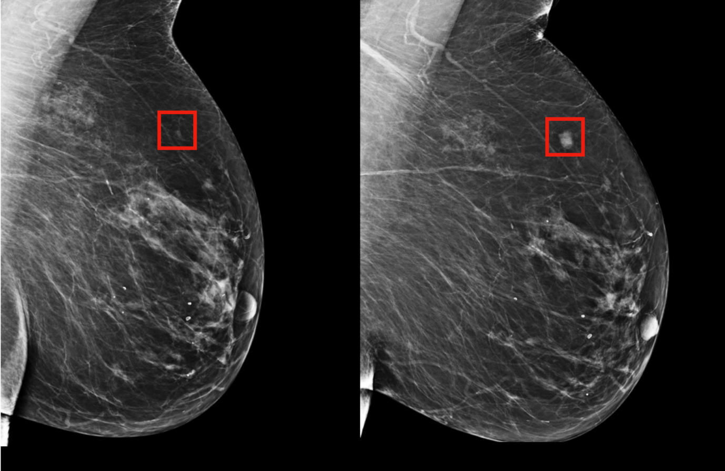
Detecting Breast Cancer with Data Mining Techniques
Team 11:
Meghna Bajoria [016661528],
Shakshi Richhariya[016043105], Vinit Kanani[016651323],
Kapil Wanaskar[016649880],
Reference

Slide 2

Meghna

Slide 3

Meghna
Shakshi

Slide 4

Meghna
Shakshi
Vinit

Slide 5

Meghna
Shakshi
Vinit
Kapil

Slide 6
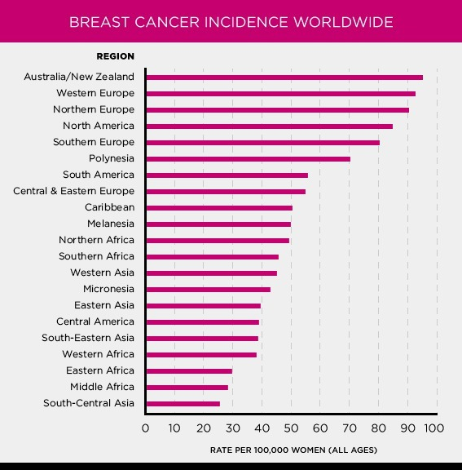
https://www.komen.org/breast-cancer/facts-statistics/breast-cancer-statistics/

Slide 7
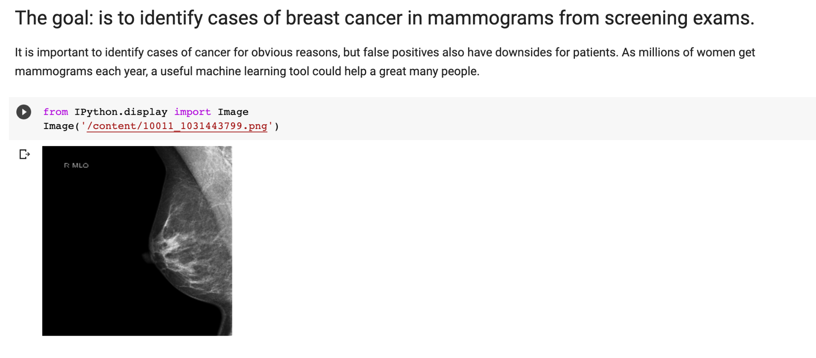

Slide 8
Flow
Data Extraction
EDA
Data pre processing
Model training and evaluation
Front end and backend deployment

Slide 9
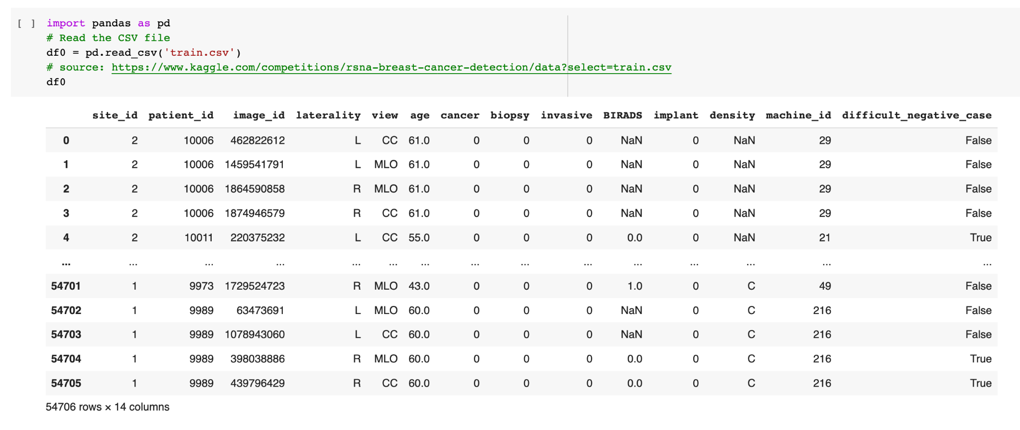

Slide 10
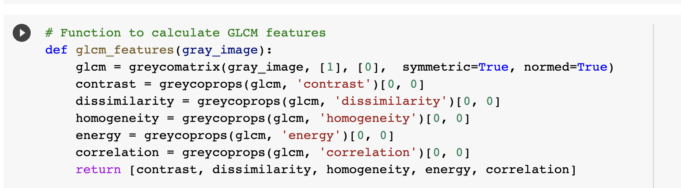
Creativity : Data Extraction from Images

Slide 11
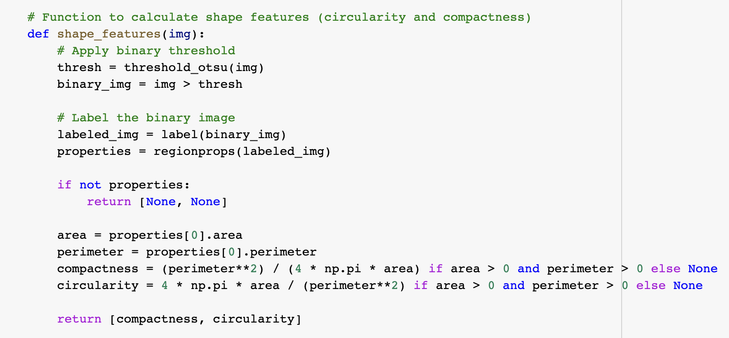
Creativity : Data Extraction from Images

Slide 12
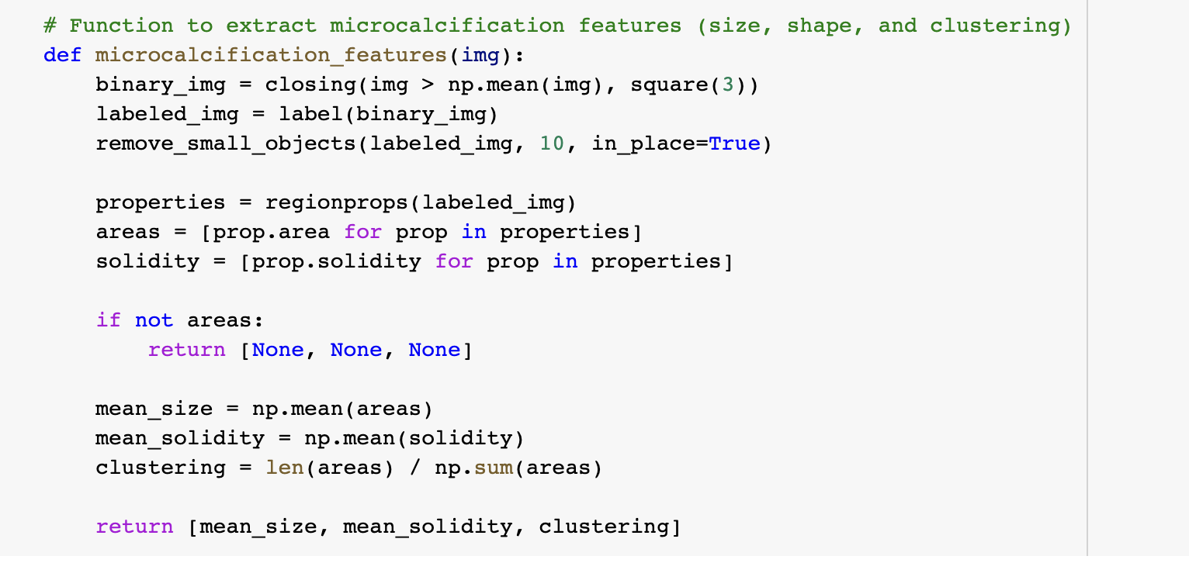
Creativity : Data Extraction from Images

Slide 13
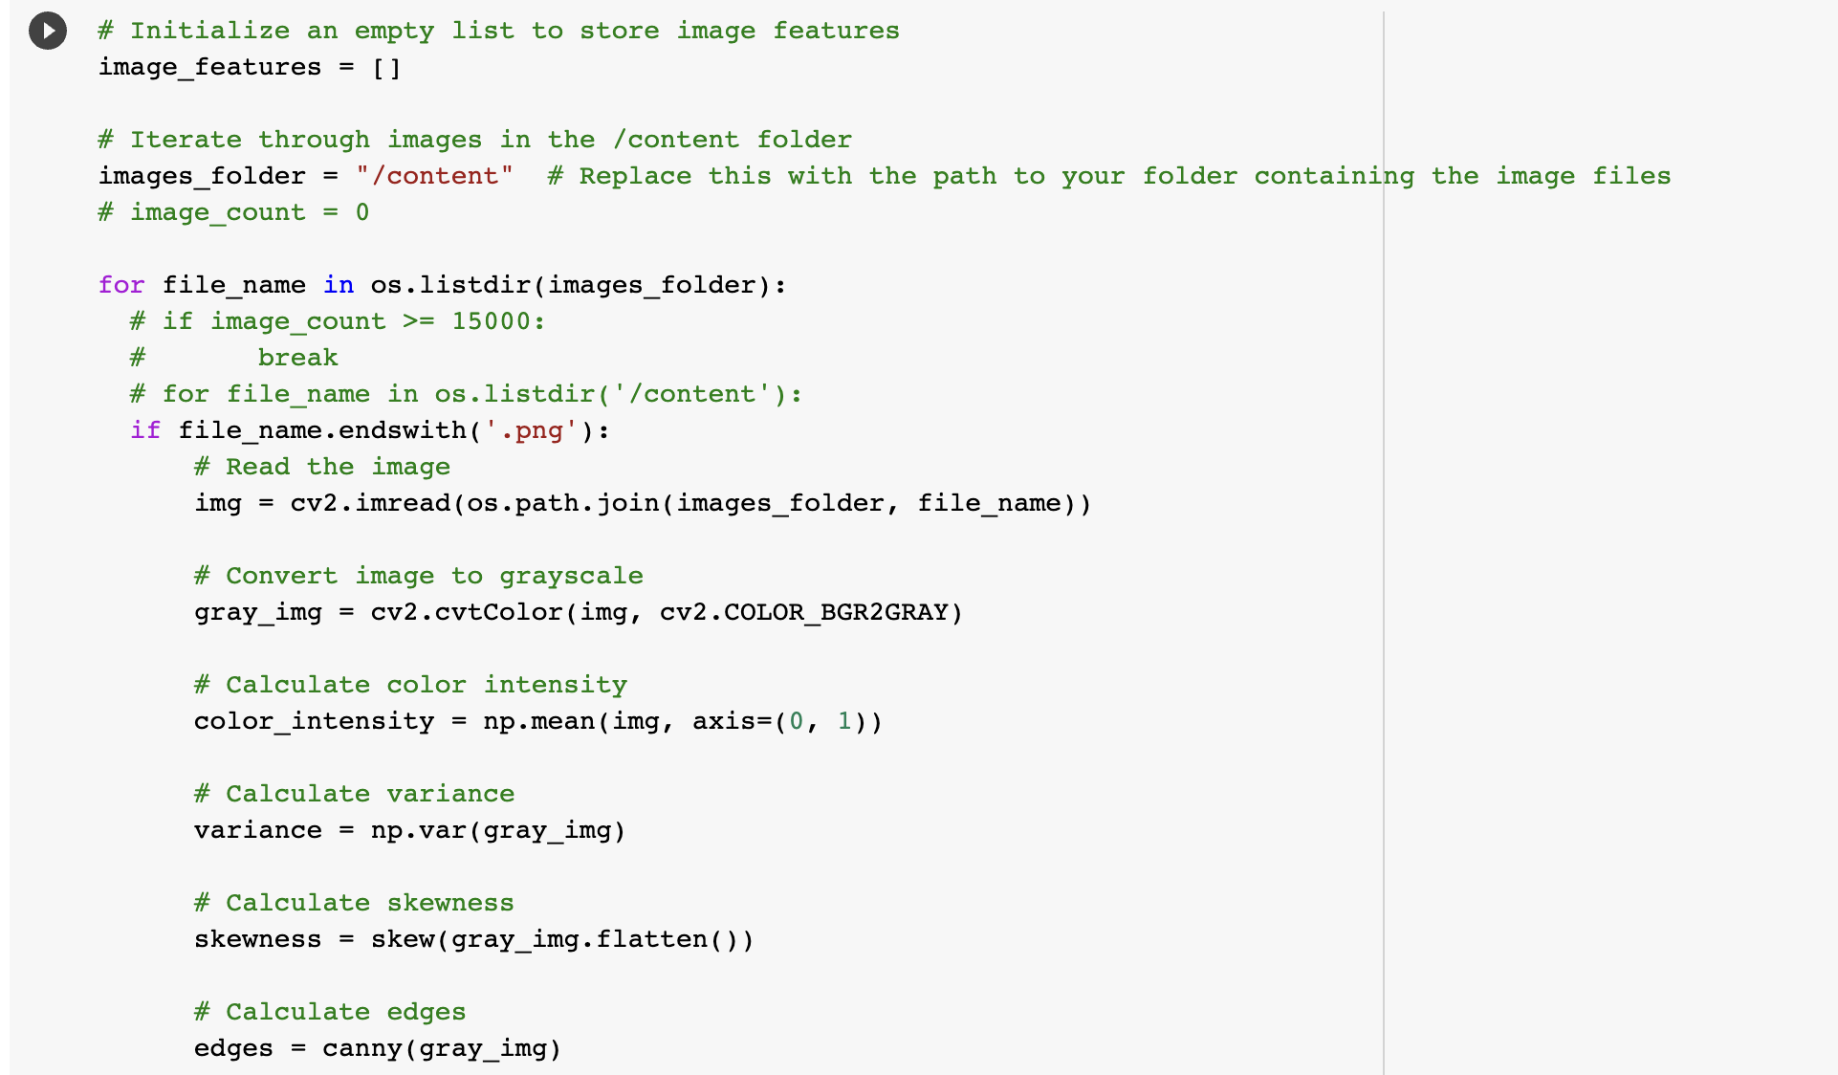
Creativity : Data Extraction from Images

Slide 14
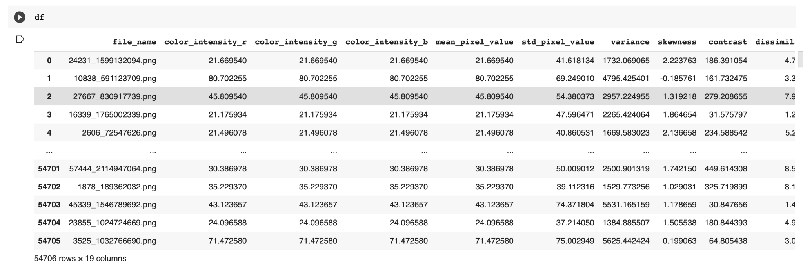
Creativity : Data Extraction from Images

Slide 15
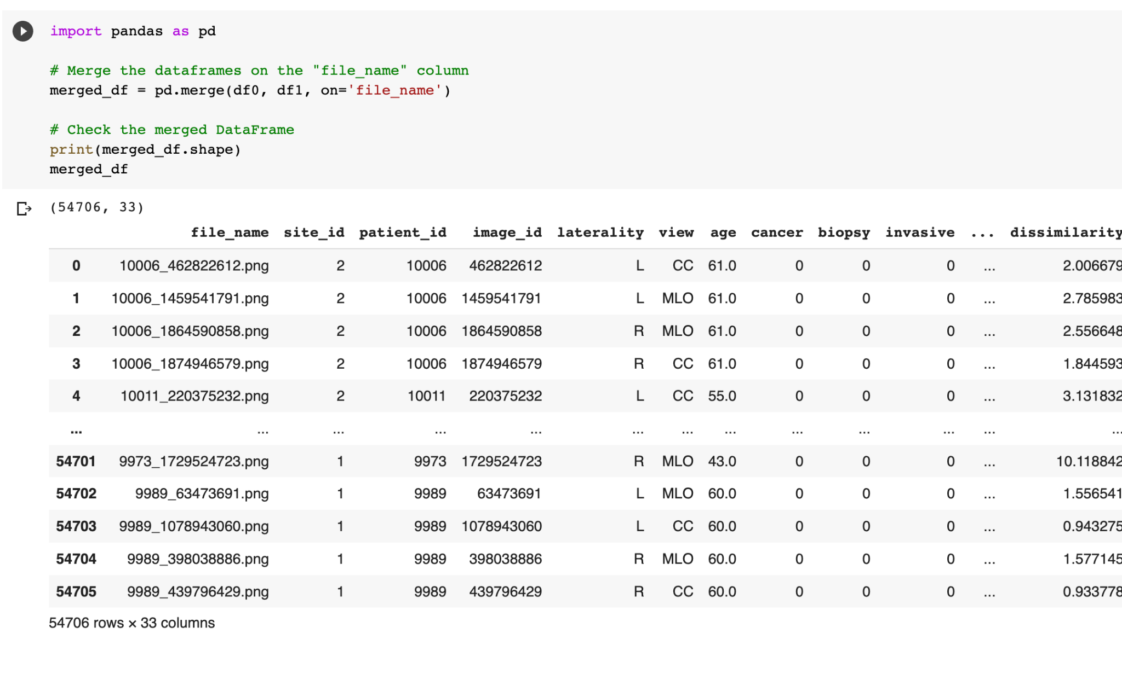

Slide 16
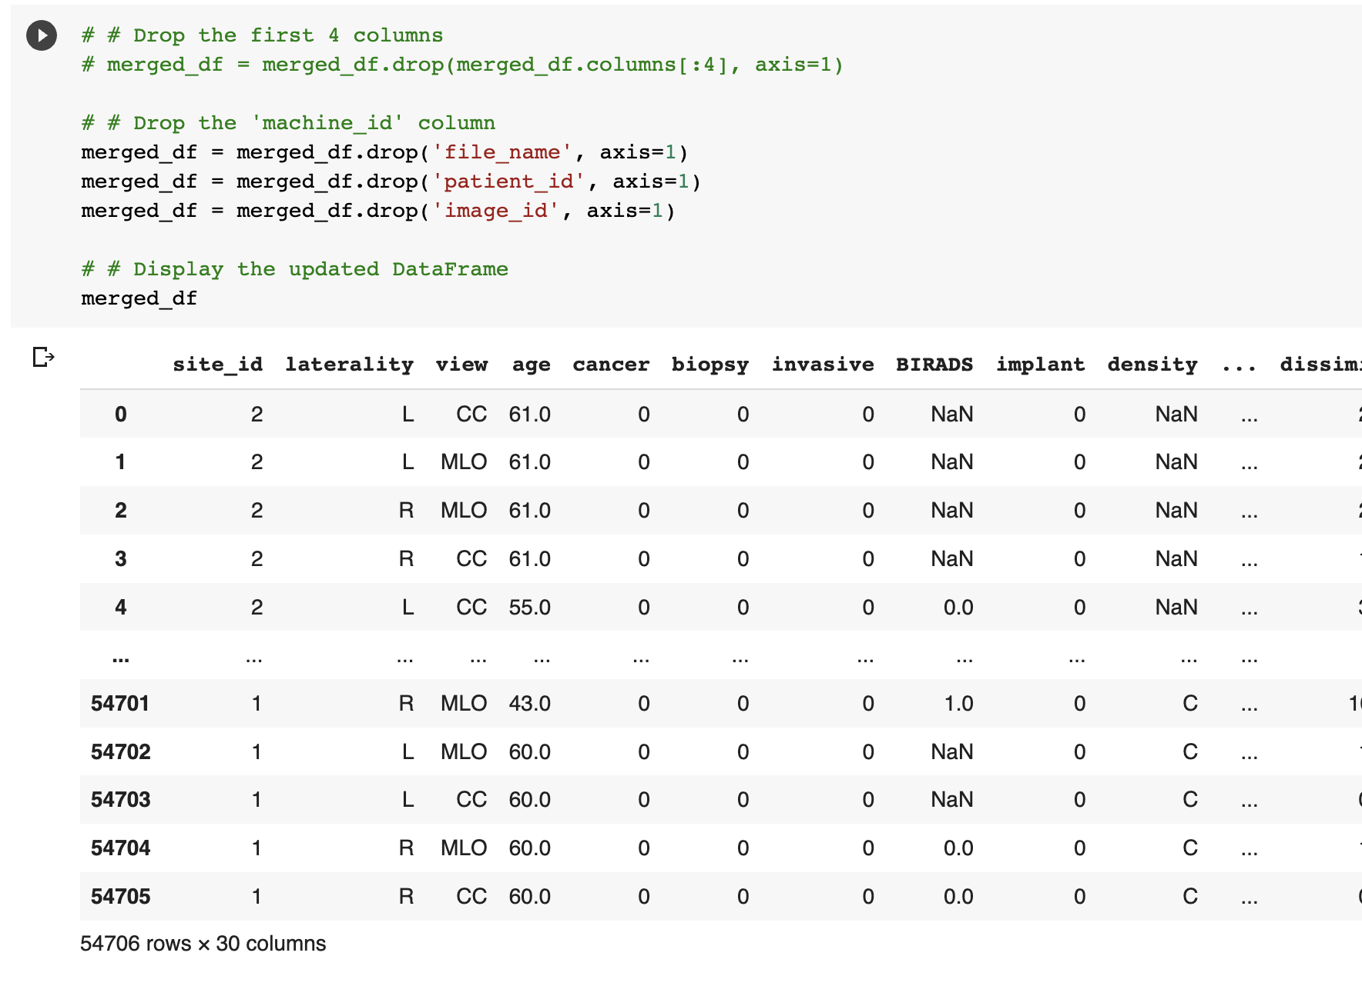

Slide 17
Exploratory Data Analysis
•EDA stands for exploratory data analysis, which is the process of analyzing and summarizing data sets to extract useful information and insights. While performing EDA, We came across several relationships between data but 2 of them were most promising.
1.There is a strong relationship between age and cancer. As people age, their risk of developing cancer increases. According to American cancer society[1] breast cancer mainly occurs in middle-aged and older women. The median age at the time of breast cancer diagnosis is 62. This finding is consistent with our findings in this dataset.
2.A biopsy is a medical procedure that involves the removal of a small sample of tissue or cells from the body for examination under a microscope. Therefore, cancer and biopsy both have strong correlation with each other.

Slide 18
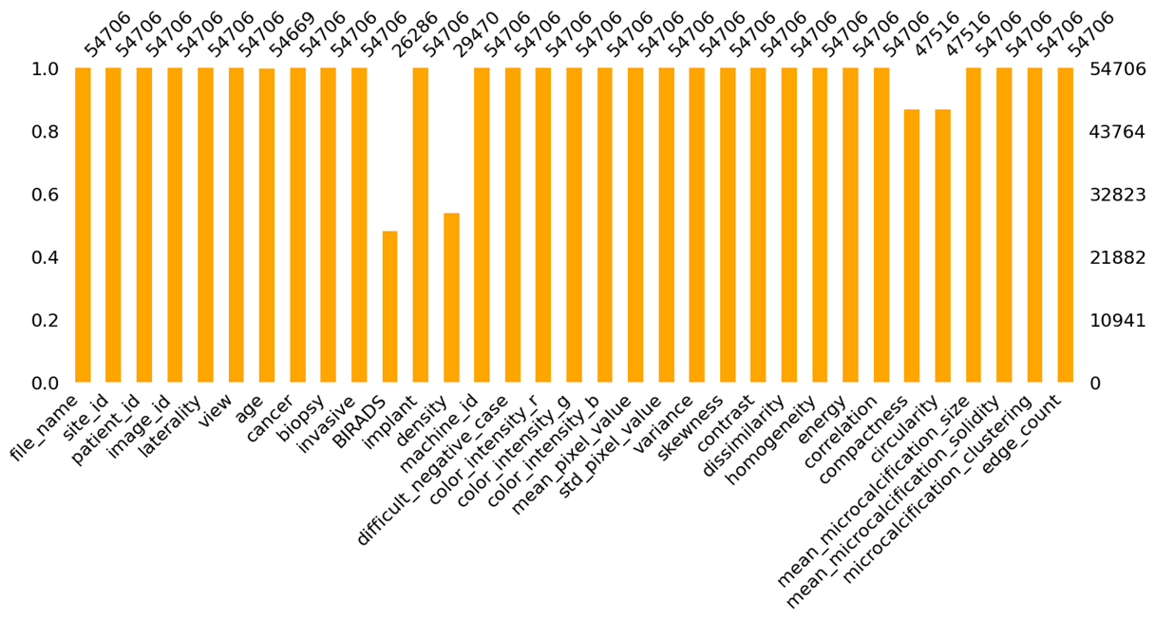
Missing values
There are multiple missing values in our dataset. All of these missing values are limited to 4 columns. It is really important to find missing values in our dataset because missing data can introduce bias and reduce the accuracy of our analysis.

Slide 19
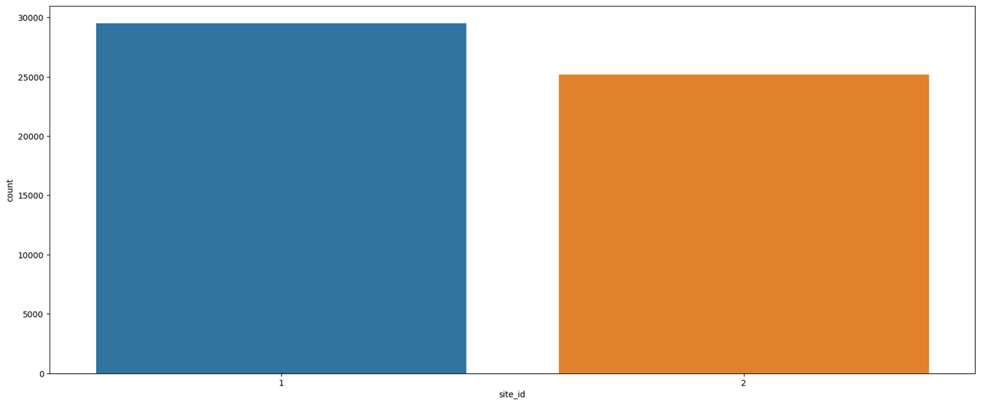
Site_id
The `site_id` attribute is important because it provides information about the source hospital that collected the data. This information can be useful in determining if there are any variations in the data collection process across different hospitals, which may affect the quality and reliability of the data. For example, certain hospitals may have different imaging devices, screening protocols, or biopsy practices that could potentially impact the accuracy of the breast cancer diagnosis. Understanding the source hospital can help researchers identify and control for any such differences, and potentially improve the quality of their analyses and predictions. Additionally, `site_id` can be useful for tracking the origin of the data, and for ensuring the privacy and security of patient information.

Slide 20
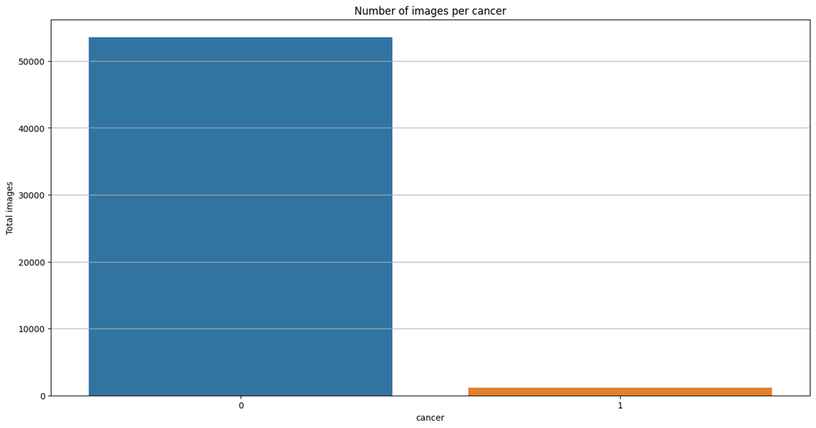
Number of images per cancer
It was seen that most of the images correspond to Mammographies of non-cancer patients. This could be a challenge for the overall prediction as the percentage of cancer images is low.

Slide 21
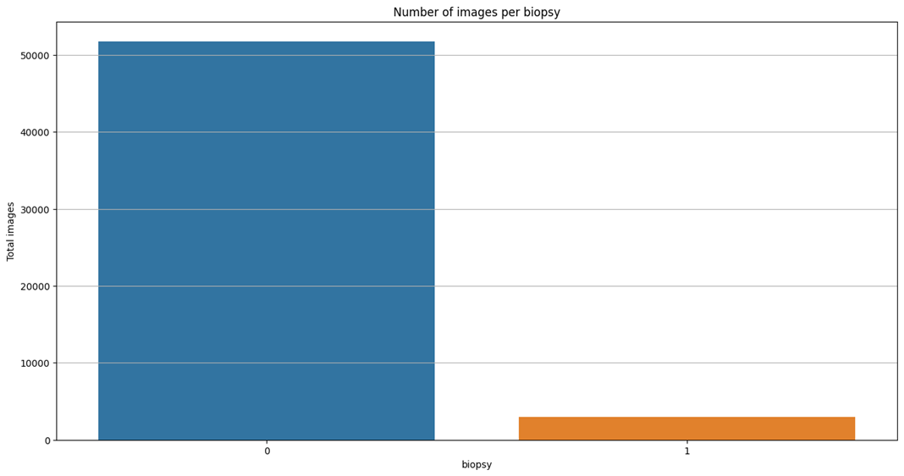
Biopsy
Biopsy also showed a similar trend where all the patients who underwent biopsy did not necessarily have cancer.

Slide 22
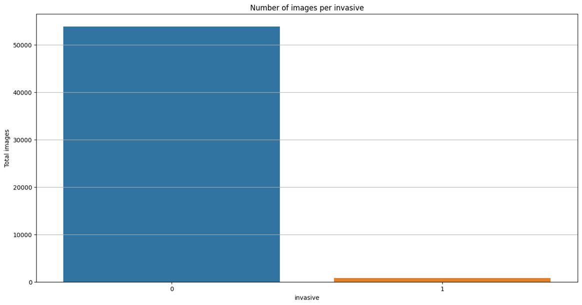
Number of images per invasive
It can be observed that not all the cancer images represent an invasive/harmful disease.

Slide 23
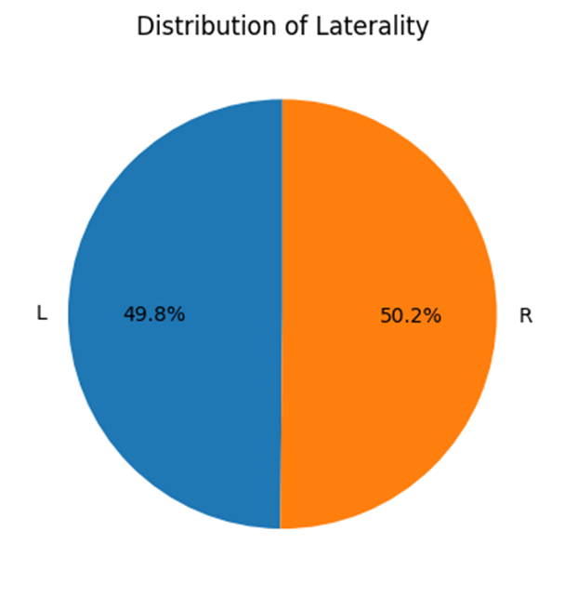
Distribution of laterality
The number of images for each laterality is almost equal for all the patients. This shows that screening Mammography is done on both breasts. This is a positive sign as it reduces the potential for biases or underrepresentation of either side. It also means that any differences or asymmetries in the prevalence or severity of breast cancer between the left and right sides can be more accurately assessed and analyzed.

Slide 24
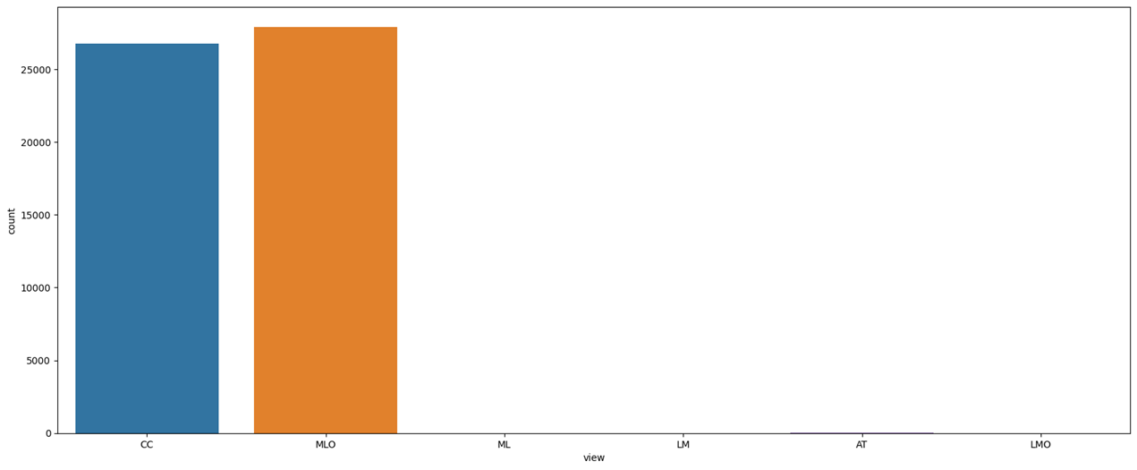
Images per view
Majority of data is taken in CC (cranial-caudal) or MLO (mediolateral oblique) view. This suggests that these two views are commonly used in breast imaging and are likely important for accurate diagnosis and assessment of breast health. The extremely low count of images taken in the AT (axial) view suggests that this view may not be commonly used in breast imaging or may not be as useful for assessing breast health as the CC and MLO views.

Slide 25
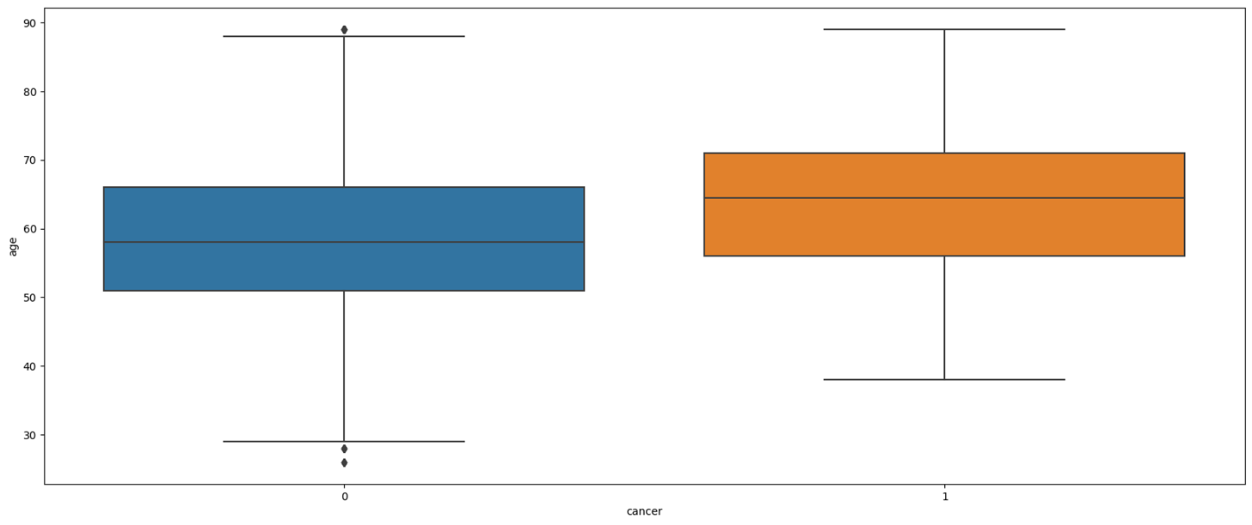
Outliers for age
We notice few outliers specifically the patients that are below the age of 30 and near 90 years of age.

Slide 26
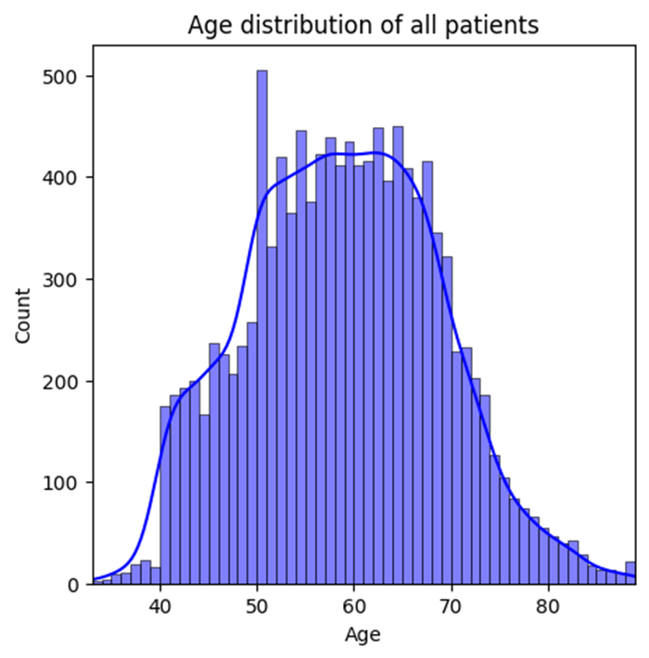
Age distribution of all patients
We notice a normal distribution. A normal distribution of age for all patients suggests that the ages of the patients in the dataset are evenly distributed around a central value, with relatively few patients at the extremes of the age range.

Slide 27
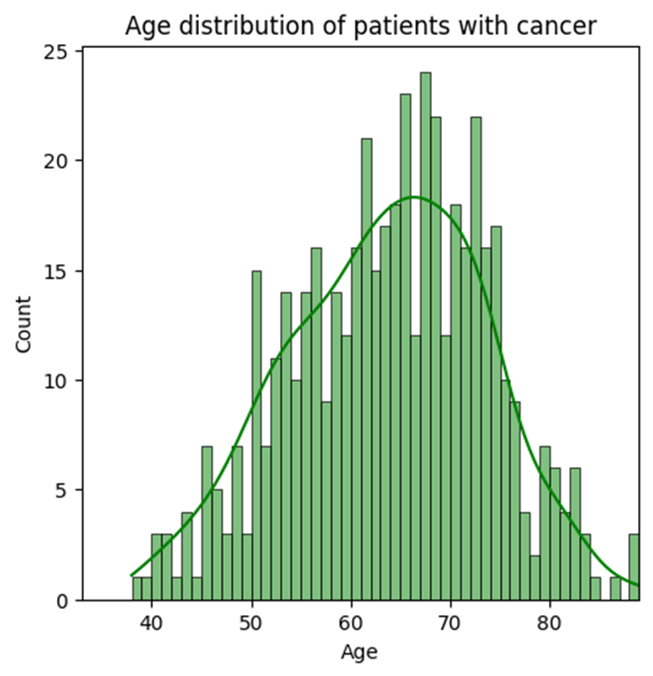
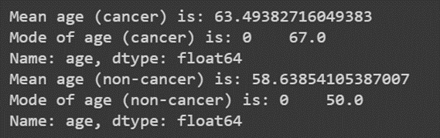
Age distribution of all patients with cancer
We can observe that the age of patients with cancer is negatively skewed. This means that most of the patients who had cancer were near the age of 60.

Slide 28
•The mean and mode age of patients with cancer and without cancer in the dataset can provide insights into the typical age range of patients with and without cancer.
•The mean age of patients with cancer is 63.49 years, while the mean age of patients without cancer is 58.64 years. This suggests that patients with cancer tend to be older than those without cancer.
•The mode age of patients with cancer is 67 years, while the mode age of patients without cancer is 50 years. The mode represents the most common value in the dataset, so this indicates that the most common age for patients with cancer is 67 years, while the most common age for patients without cancer is 50 years.
•These findings are in line with what is known about breast cancer incidence, which increases with age, with the majority of cases diagnosed in women over 50 years old. Therefore, it is important to take age into account when analyzing breast cancer data and developing machine learning models to ensure that the models accurately reflect the age distribution of the real-world population.
•So we can conclude that age is an important factor for cancer.

Slide 29
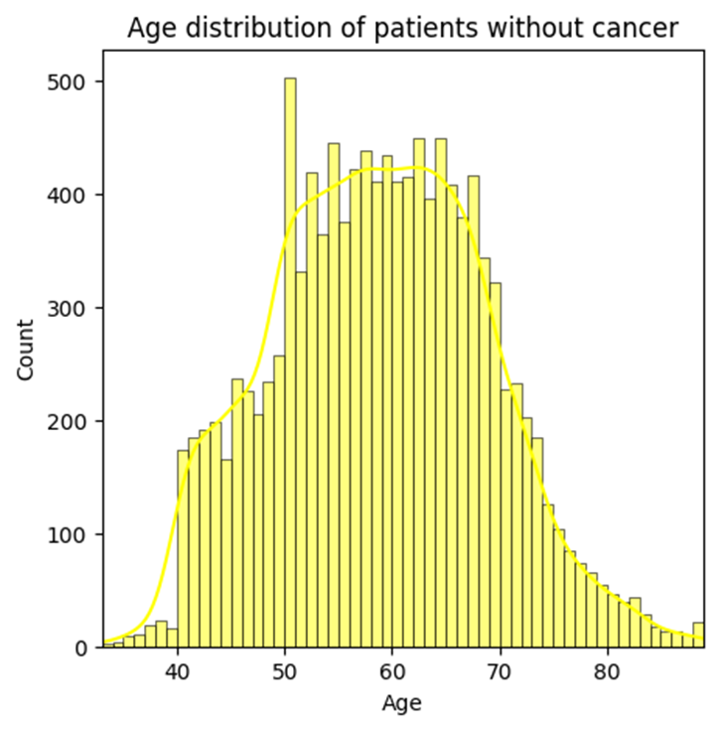
Age distribution of all patients without cancer
Age distribution of patients without cancer follows a normal distribution

Slide 30
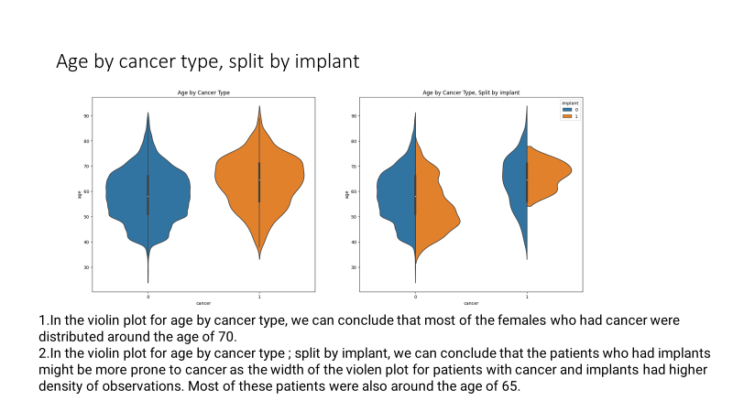

Slide 31
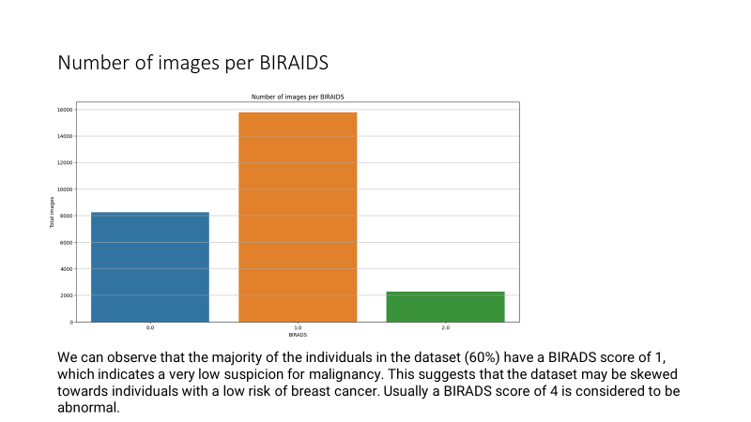

Slide 32
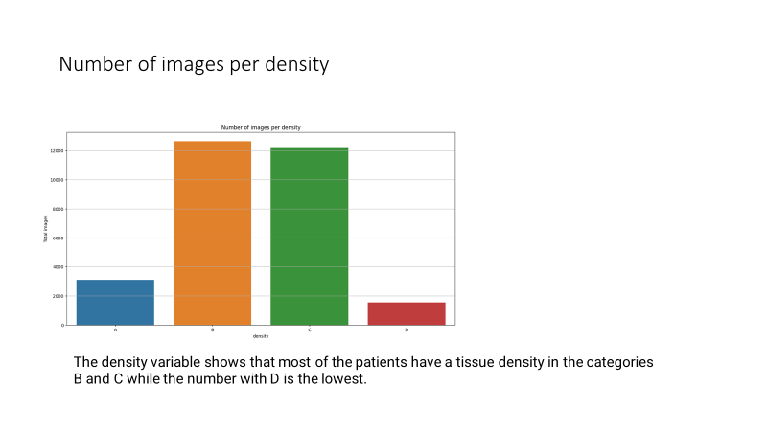

Slide 33
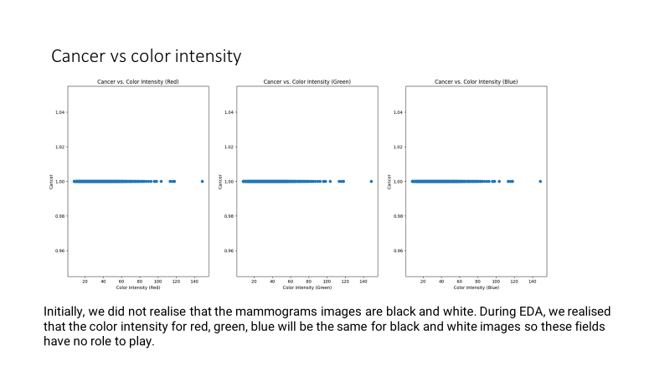

Slide 34
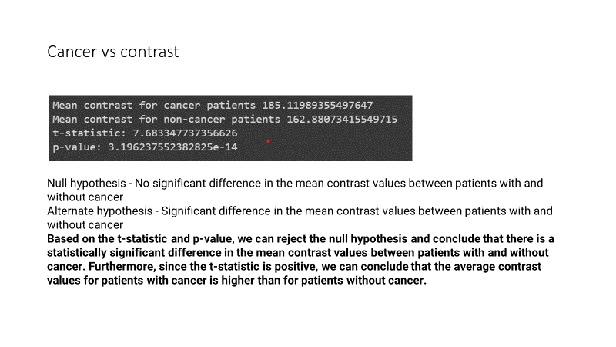

Slide 35
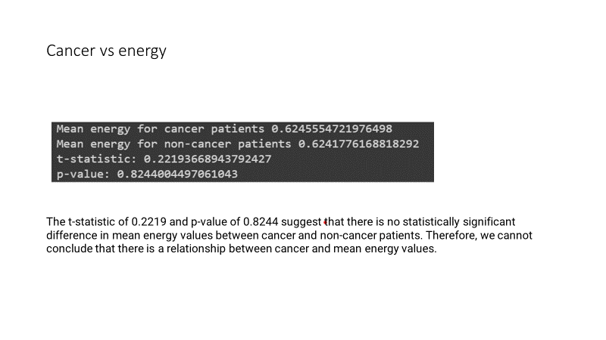

Slide 36
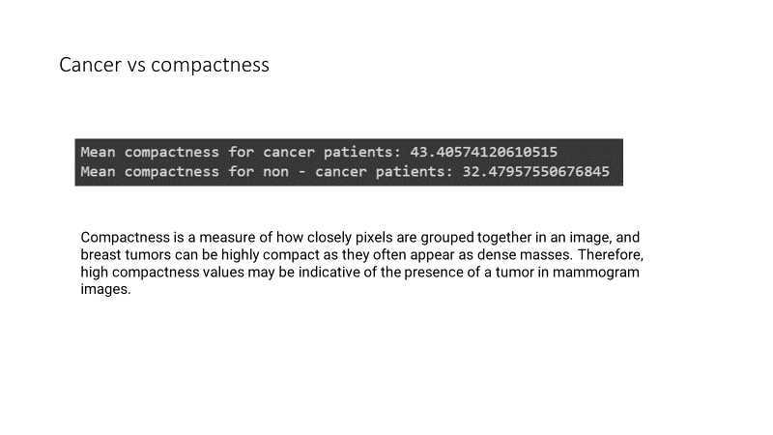

Slide 37
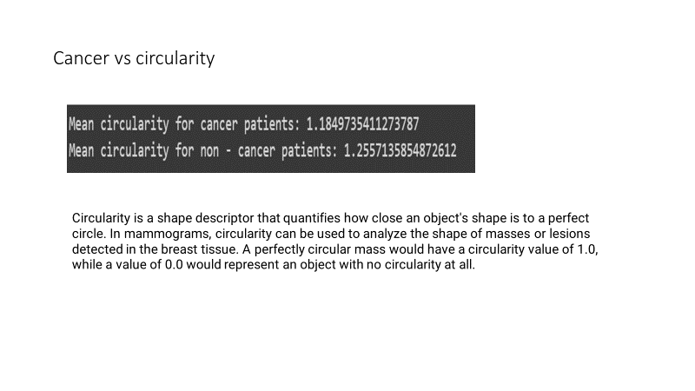

Slide 38
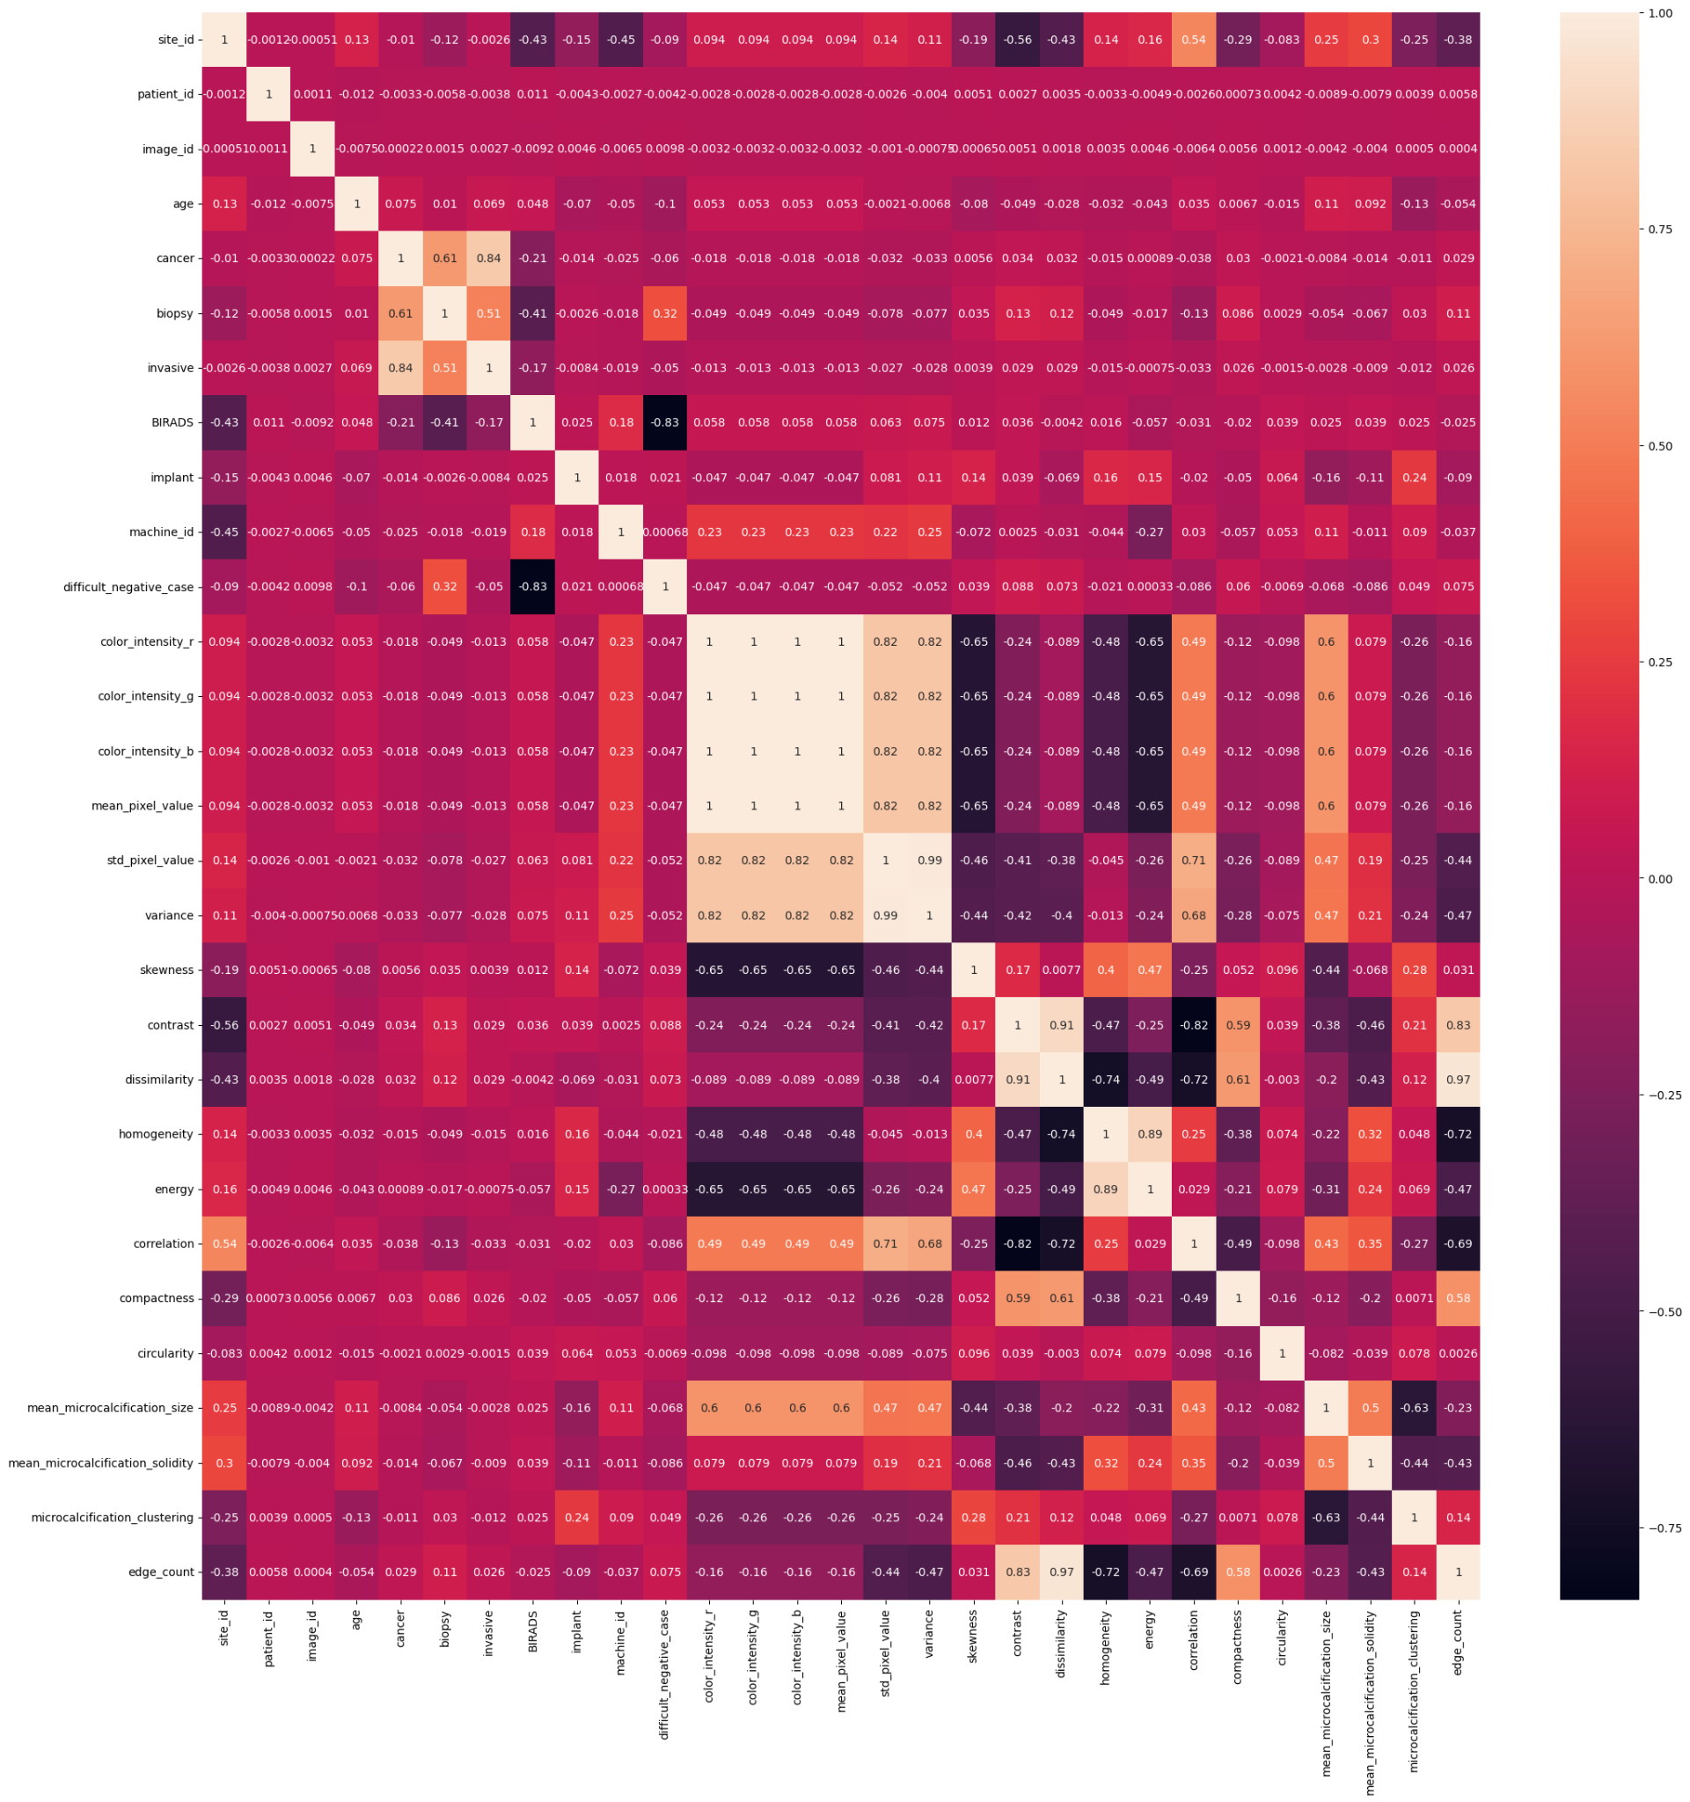

Slide 39
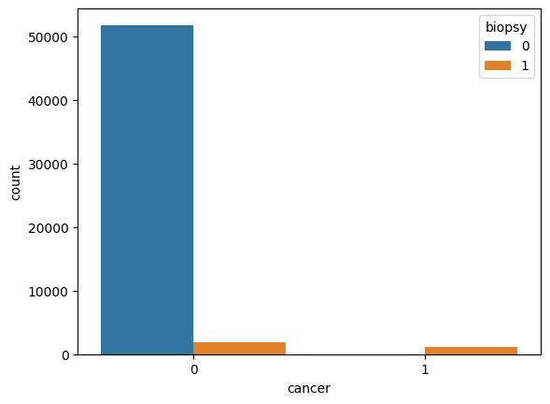
Cancer vs biopsy
We can see that biopsy does have a strong correlation to cancer. If cancer is not present, biopsy has also shown the same output for most of the data. And when cancer is presnt, we can see that biopsy has also returned the same value.

Slide 40
Conclusion for EDA
There is a strong relationship between age and cancer. As people age, their risk of developing cancer increases. According to American cancer society breast cancer mainly occurs in middle-aged and older women. The median age at the time of breast cancer diagnosis is 62. This finding is consistent with our findings in this dataset.
A biopsy is a medical procedure that involves the removal of a small sample of tissue or cells from the body for examination under a microscope. Biopsies are often used to diagnose cancer, as they can provide information about the presence of cancerous cells and their characteristics. The relationship between cancer and biopsy is therefore very important. A biopsy is typically recommended when cancer is suspected based on symptoms or imaging tests, such as X-rays, CT scans, or MRIs. By examining the biopsy sample, doctors can confirm the presence of cancer, determine its type and stage, and develop an appropriate treatment plan.

Slide 41
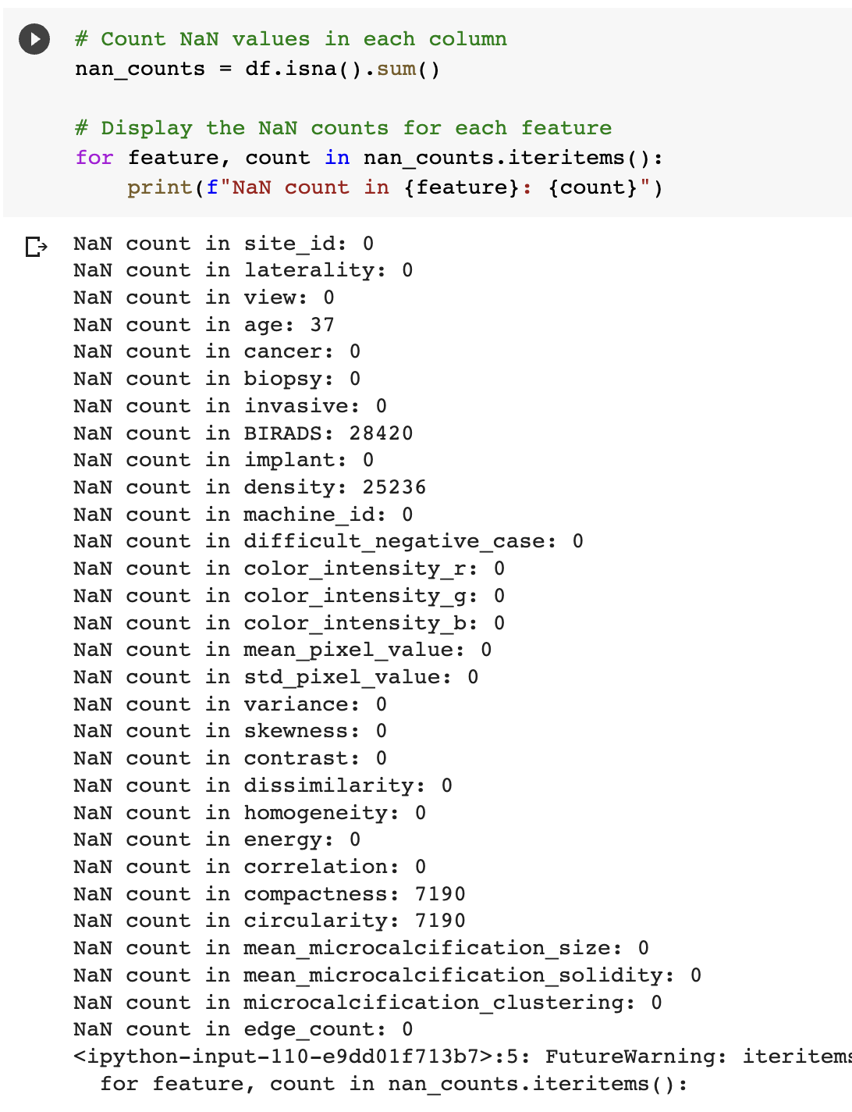
Remove – Nan values

Slide 42
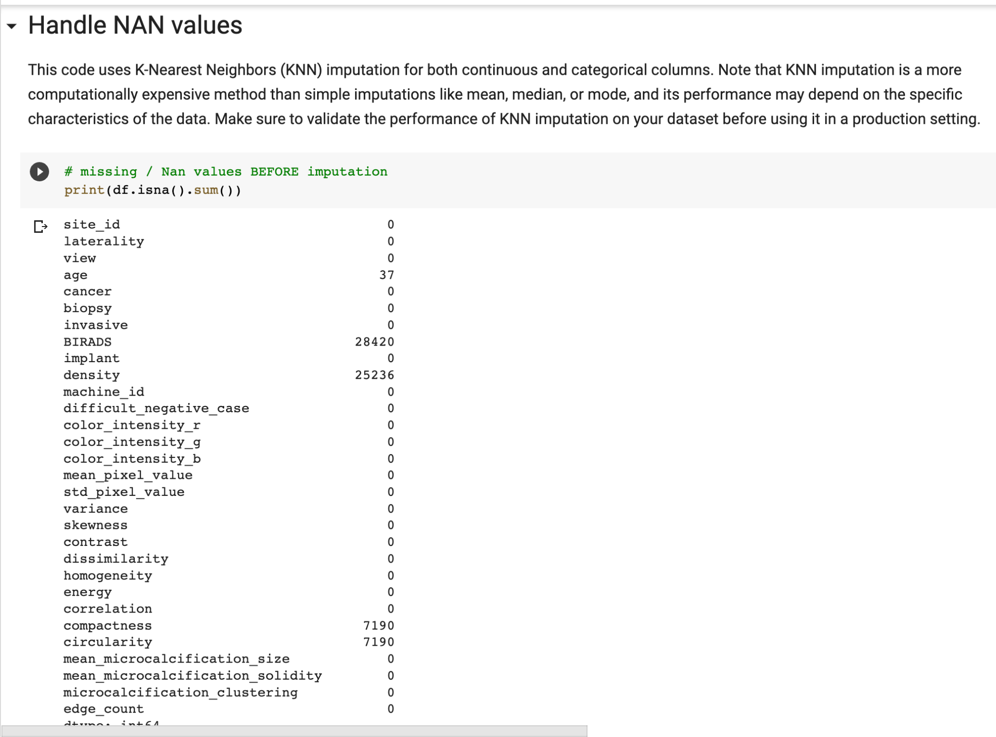
Remove – Nan values

Slide 43
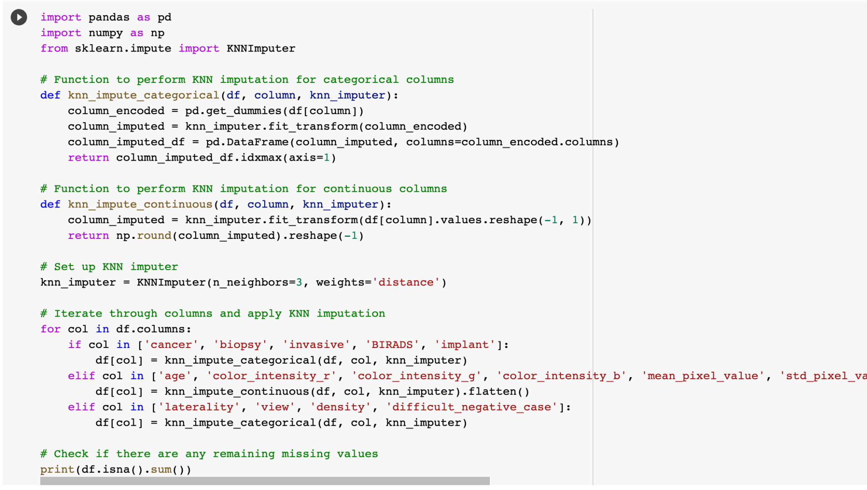

Slide 44
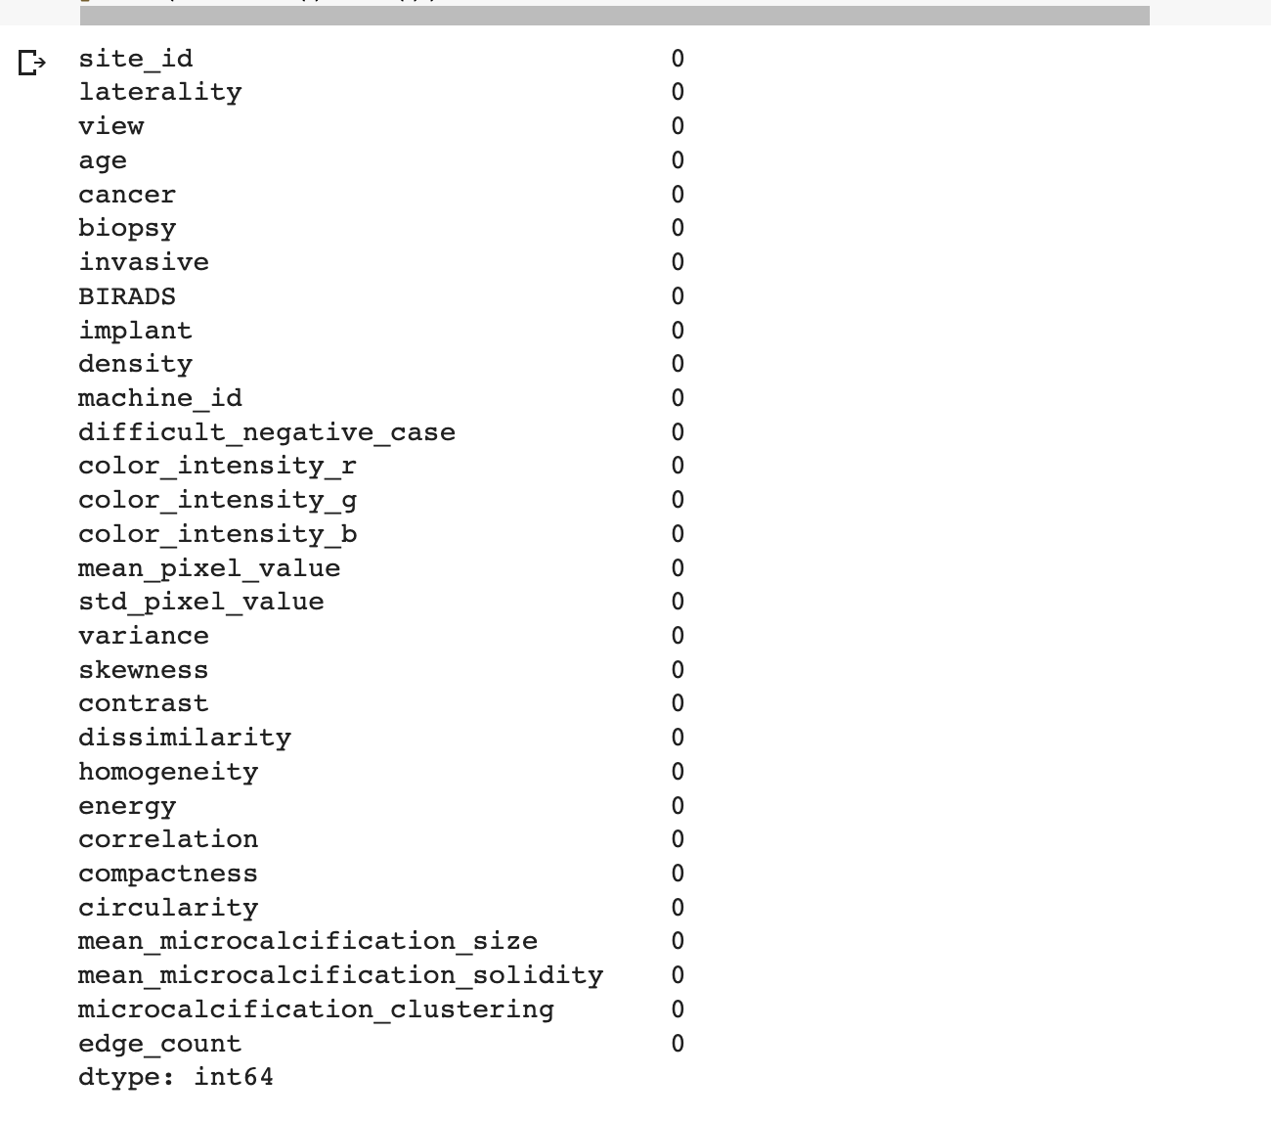

Slide 45
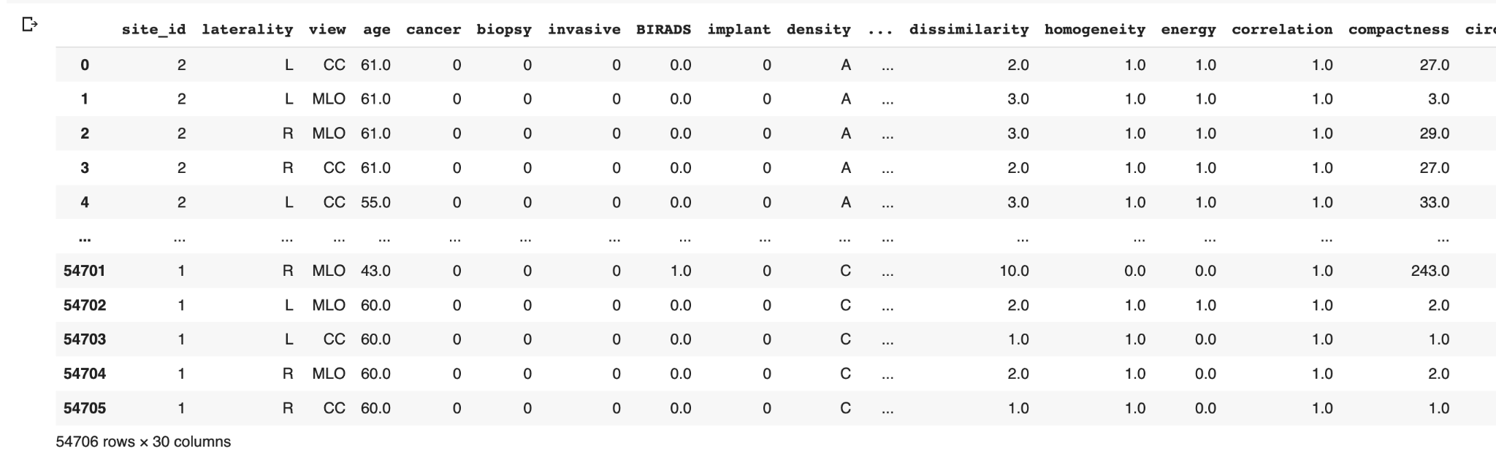
Pre - Processed Data

Slide 46
Contribution to Society:
Our project makes significant contributions to society by addressing the challenges and limitations of current diagnostic methods and leveraging data mining techniques to enhance breast cancer detection. These contributions can have a profound impact on the healthcare industry and the lives of individuals affected by breast cancer

Slide 47
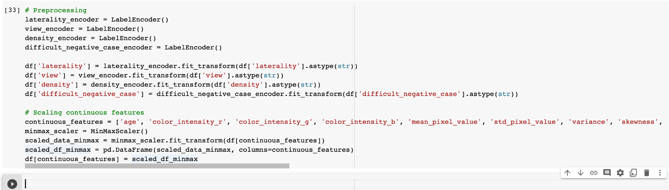
Pre - Processed Data

Slide 48
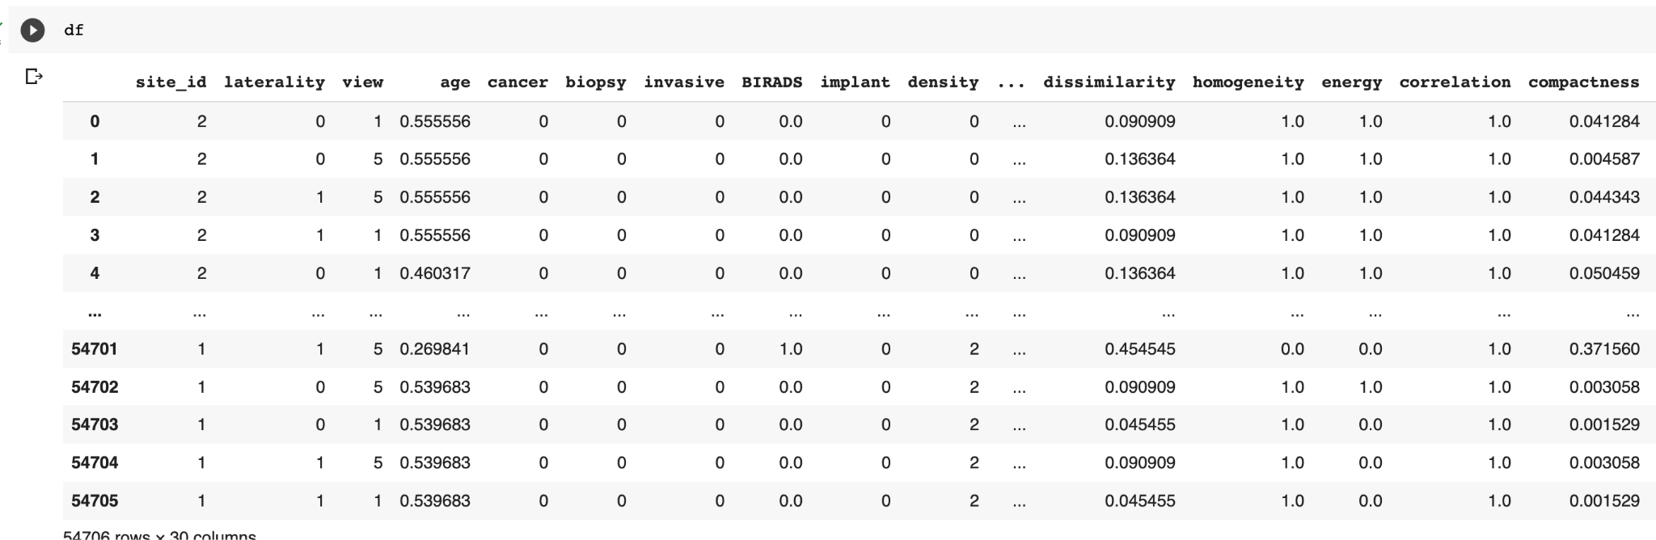
Post- Processed Data

Slide 49
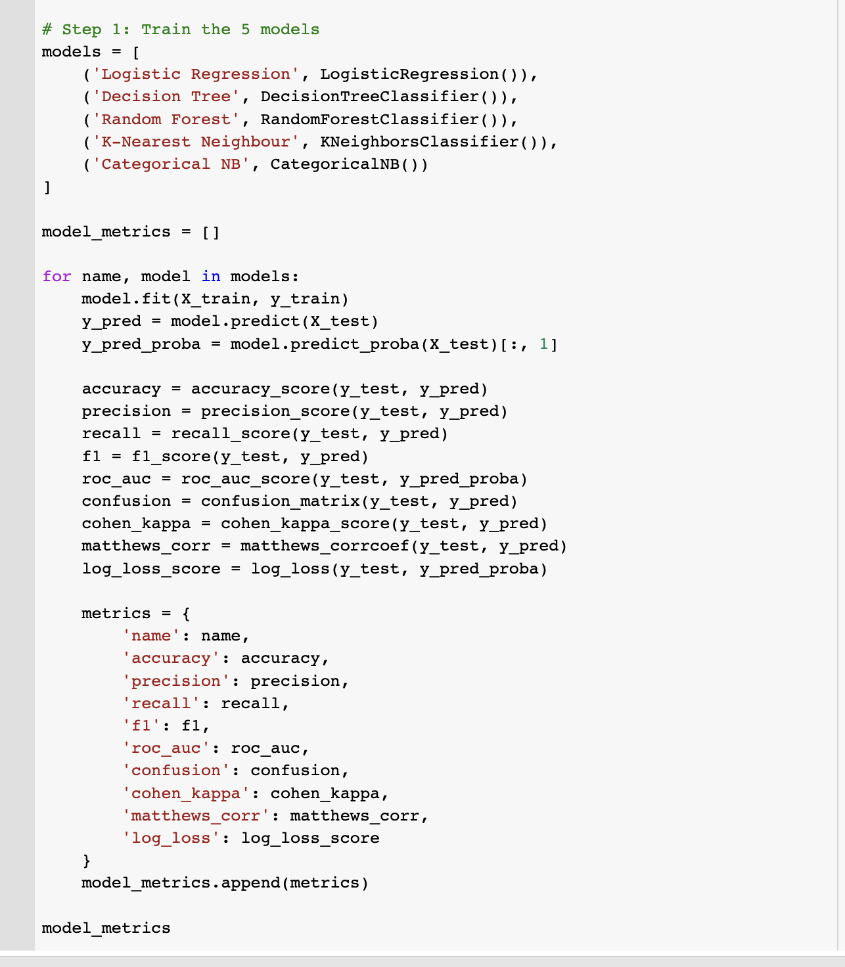

Slide 50
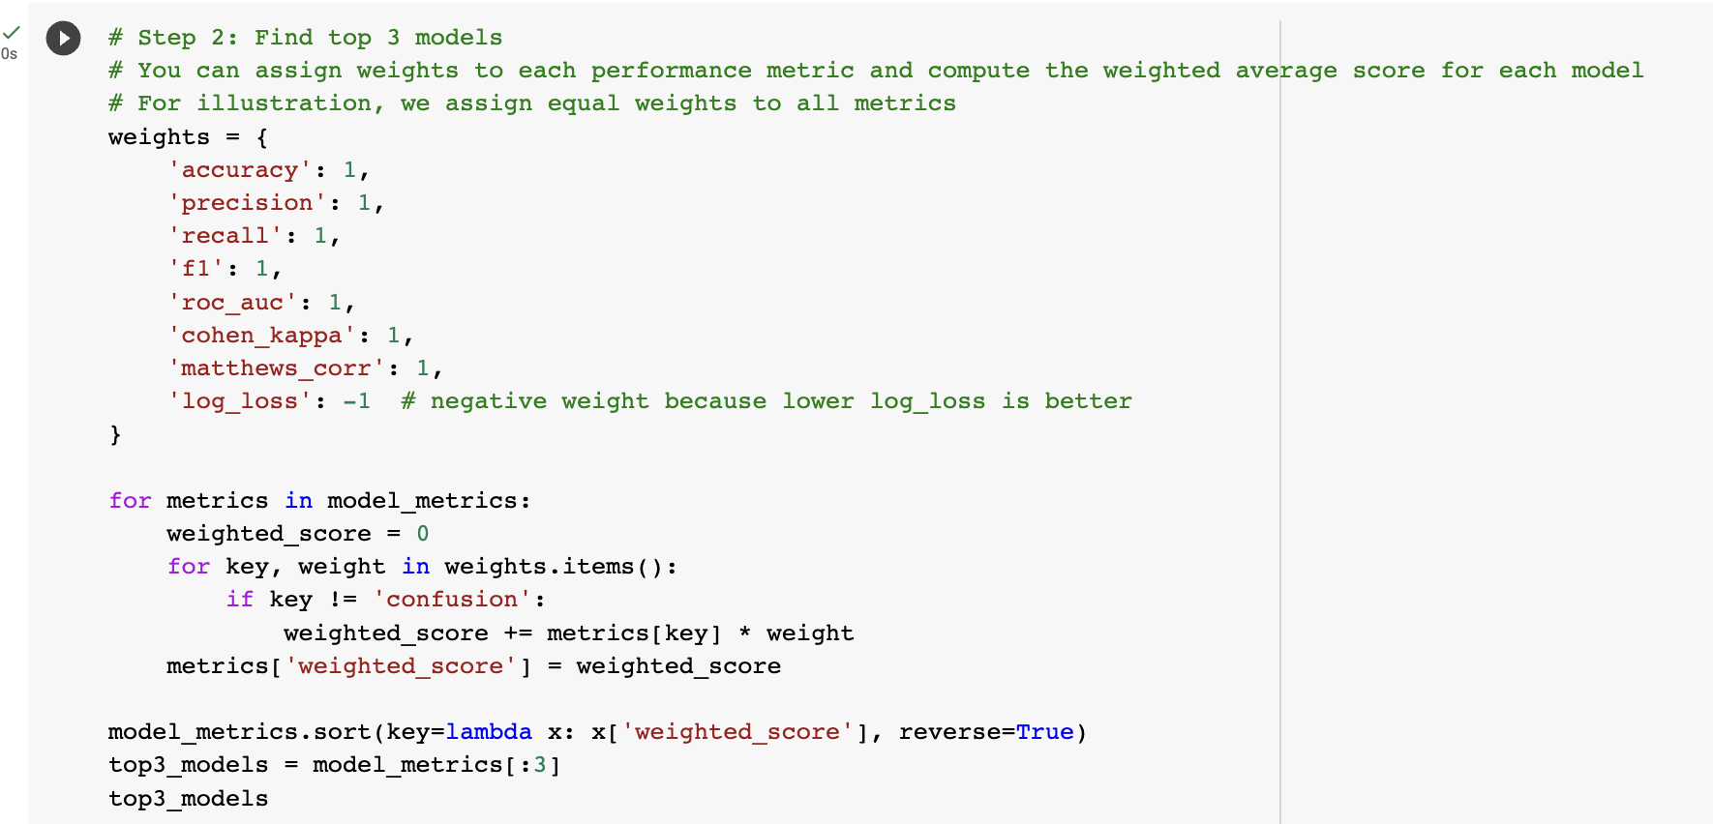

Slide 51
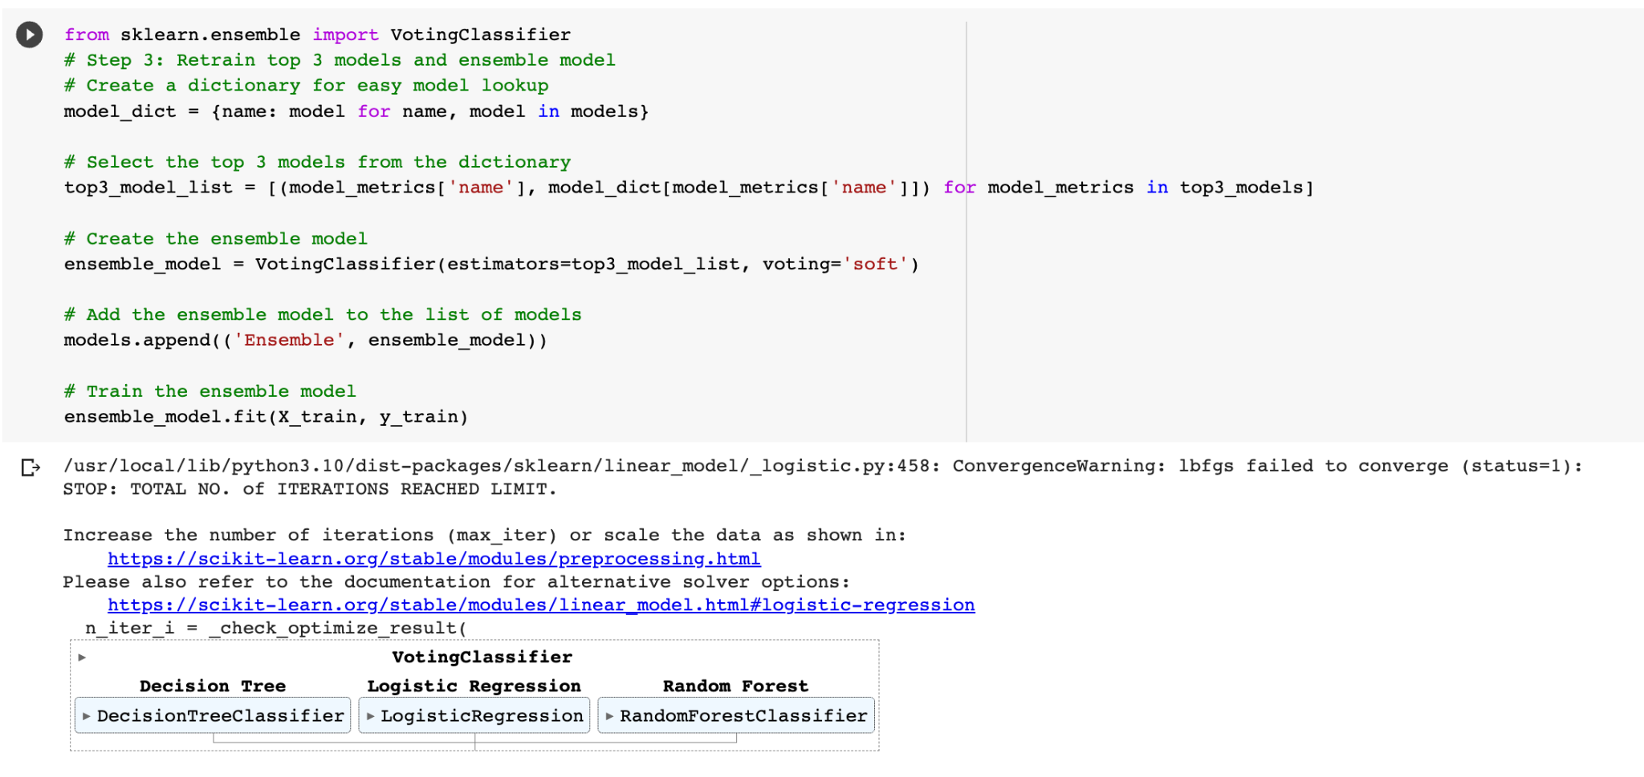

Slide 52
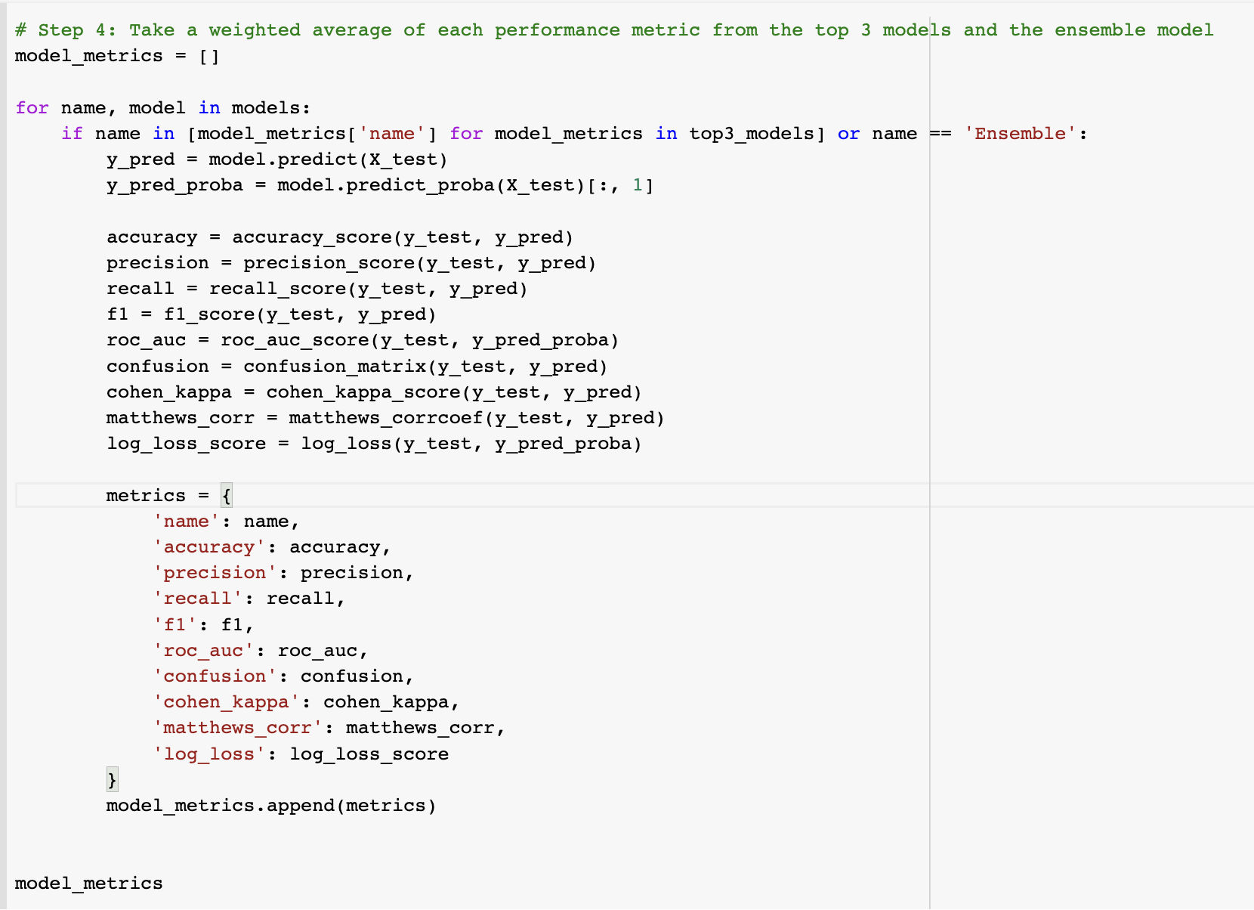

Slide 53
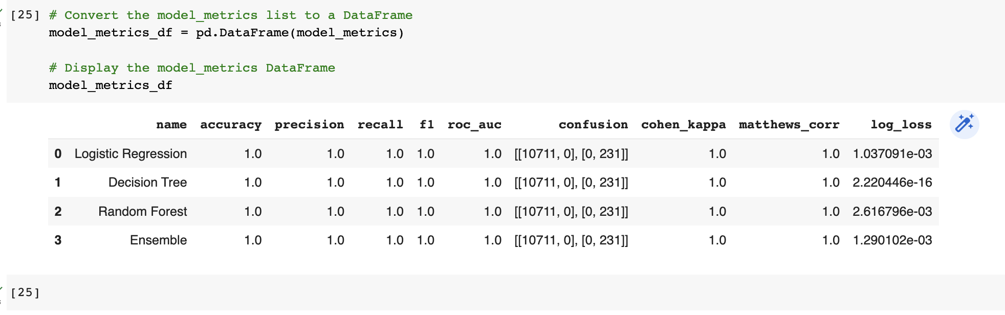

Slide 54
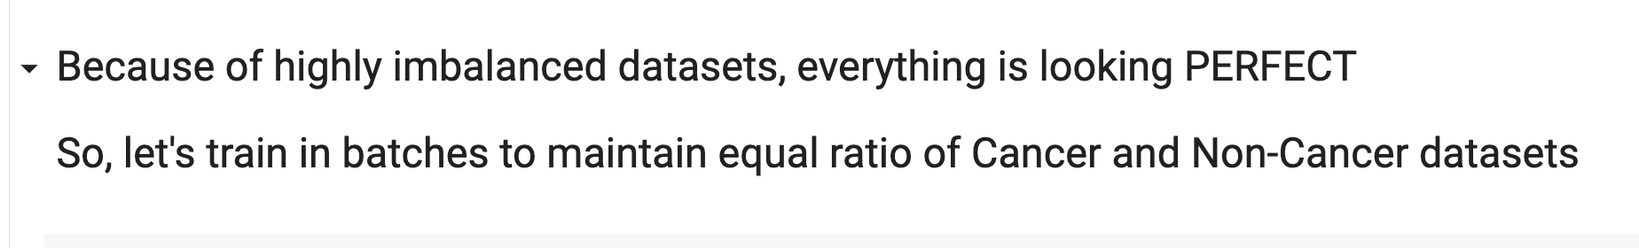

Slide 55
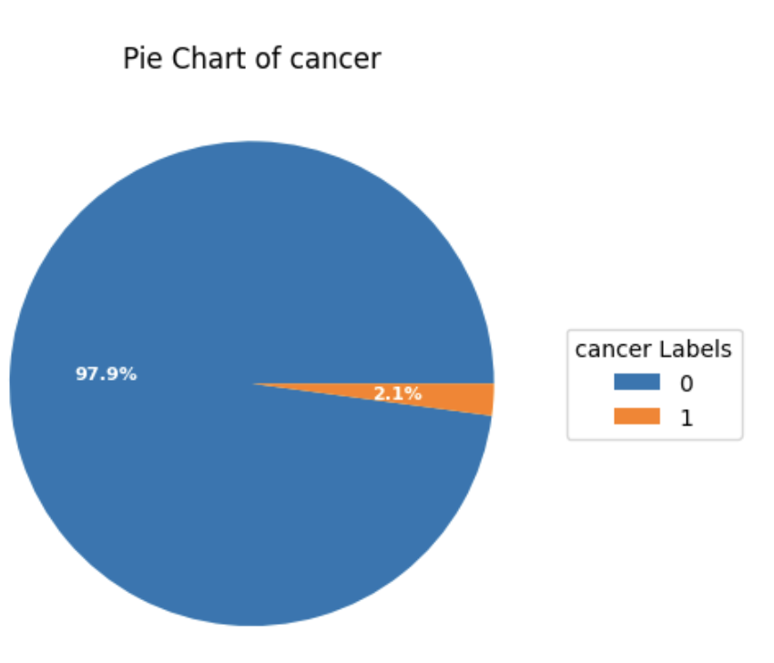

Slide 56
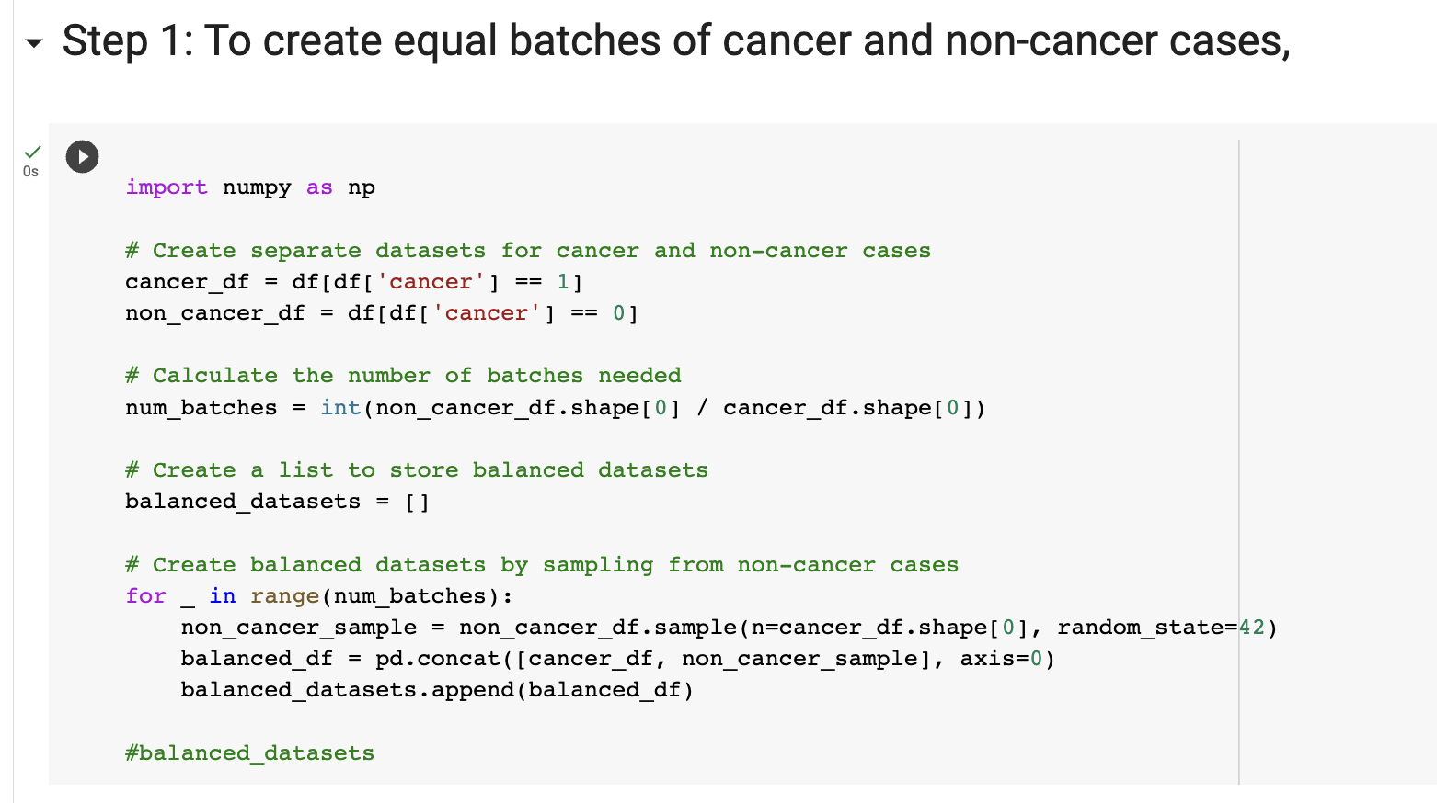

Slide 57
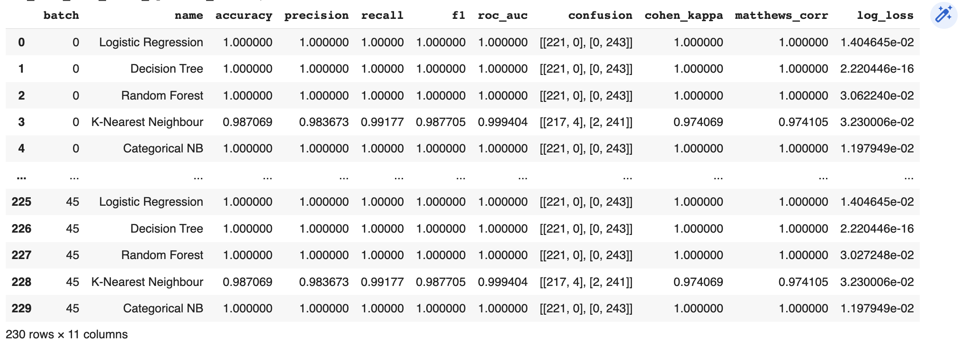

Slide 58
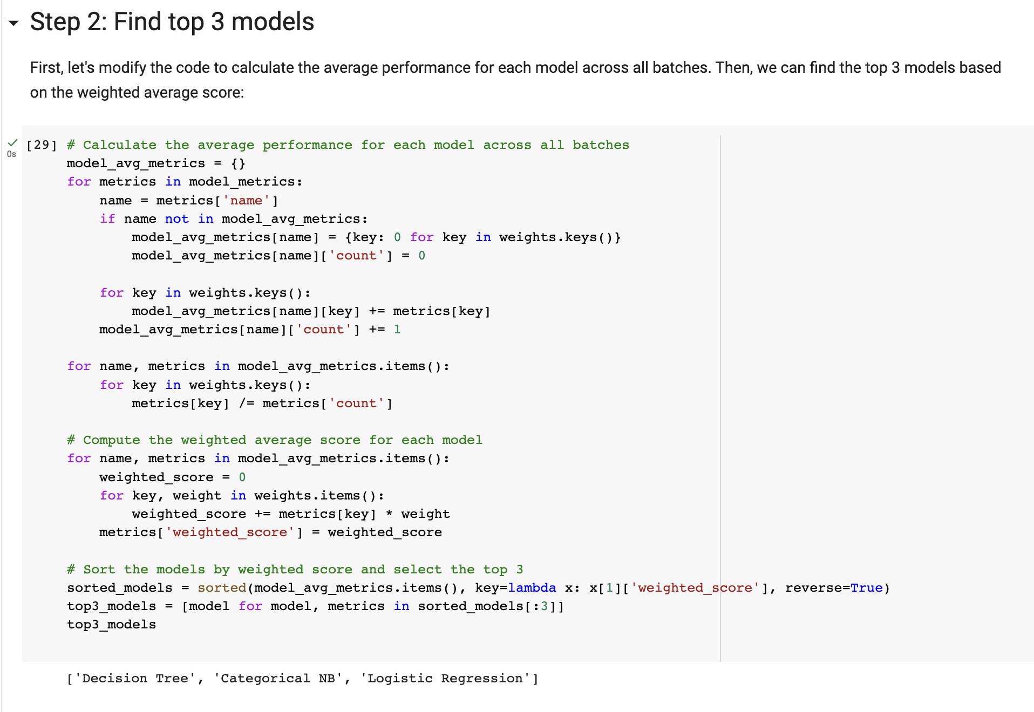

Slide 59


Slide 60


Slide 61
Creativity and Innovation:
Extracted Features from 55k images
Built an Application

Slide 62
Creativity : Data Extraction from Images

Slide 63

FrontEnd

Slide 64

FrontEnd

Slide 65
Contribution to society
Our project improves breast cancer detection through data mining, addressing limitations and enhancing accuracy.
Better detection leads to improved treatment outcomes and patient survival rates.
Our findings optimize healthcare systems, reducing costs and improving patient outcomes.

Slide 66
References
https://www.wikipedia.org/
https://chat.openai.com/chat
https://www.youtube.com/
https://www.google.com/

